Slide 1

REST APIs
Programming Applications And Frameworks (It3030)

Slide 2
Learning outcomes
After completing this lecture, you will be able to,
Describe the six REST architectural constraints.
Apply the knowledge gained in this lecture in designing proper REST APIs.
Evaluate if an API is a REST API or not.
Evaluate a given API to identify how much it conforms to the REST constraints using the Richardson Maturity Model.

Slide 3
Contents
Consuming web resources - Human vs. programs
Application Programming Interface (API)
Examples
REST
Six Architectural Constraints of REST
True REST vs. RPC (Remote Procedure Calls)
Richardson Maturity Model
Some Facilitators of REST
HTTP, JSON, HAL
Best Practices

Slide 4

Consuming web resources - Human vs. programs
How do you consume web resources?
Web browsers
Web applications
Mobile applications etc.
Source: https://illuminatingfacts.com/a-timeline-of-the-rise-and-fall-of-popular-web-browsers/

Slide 5

Consuming web resources - Human vs. programs
How do programs consume web resources?
Web APIs!
API stands for Application Programming Interface
Source: https://stileex.xyz/en/difference-computer-program-software/

Slide 6
Application Programming Interface (API)
What is an API?
A software interface which facilitates communication between two or more applications.
Abstracts away the complexities of application integrations.
A contract of services offered.

Slide 7
Application Programming Interface (API)
Examples:
RPC (Remote Procedure Calls)
CORBA Implementations (Common Object Request Broker Architecture)
SOAP (Simple Object Access Protocol)
REST (Representational State Transfer)
Mostly legacy technologies

Slide 8
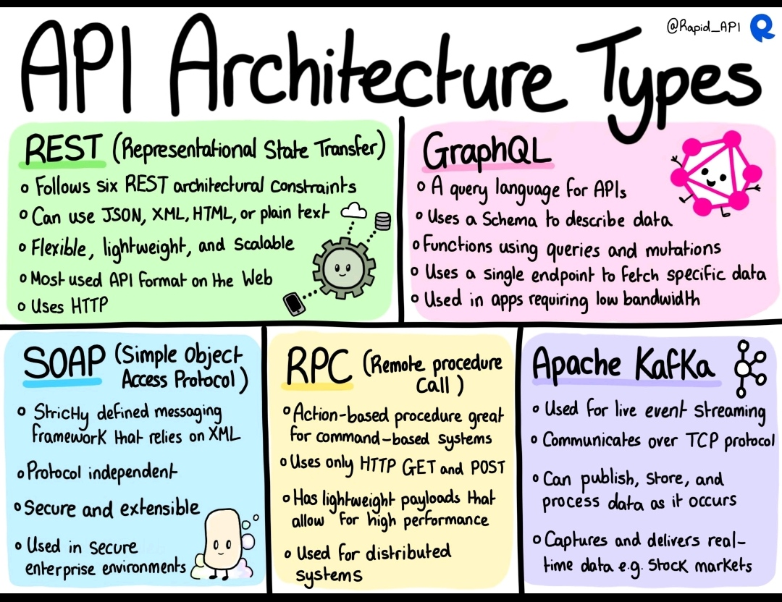
Application Programming Interface (API)
Source: https://ee.linkedin.com/posts/theo-borek-higgins_devops-api-devopslearn-activity-7028421145682944000-0YgL

Slide 9
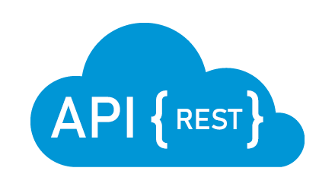
REST (Representational State Transfer)
What is REST?
an architectural style for creating web services.
Introduced by Roy Fielding in 2000 in his now famous Doctoral dissertation.
Arguably the most popular approach to creating Web APIs now.
Source: https://medium.com/@liams_o/15-fundamental-tips-on-rest-api-design-9a05bcd42920

Slide 10
REST (Representational State Transfer)
Why is REST Popular?
Just an architectural style (not a technology or a full-blown protocol like SOAP)
If the API aligns with the six REST constraints, it is a REST API
No strict rules, very flexible
Simple to use and learn compared with previously used approaches (e.g., SOAP/ CORBA etc.)
Runs on HTTP Protocol

Slide 11
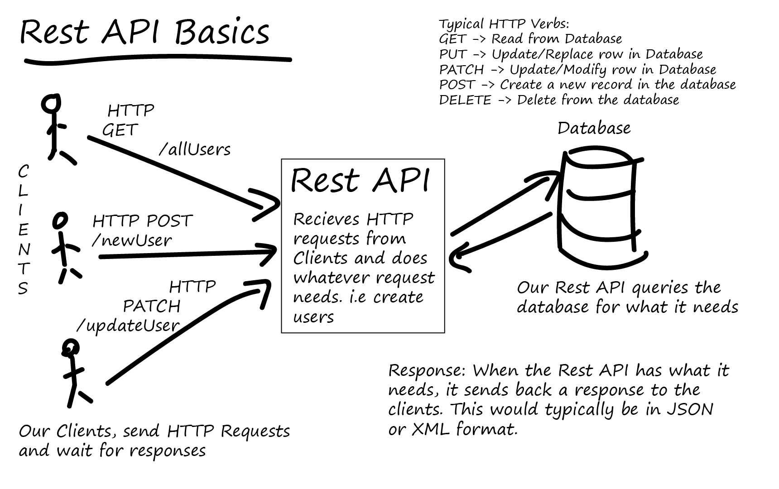
REST (Representational State Transfer)
Source: https://tutorialedge.net/software-eng/what-is-a-rest-api/

Slide 12
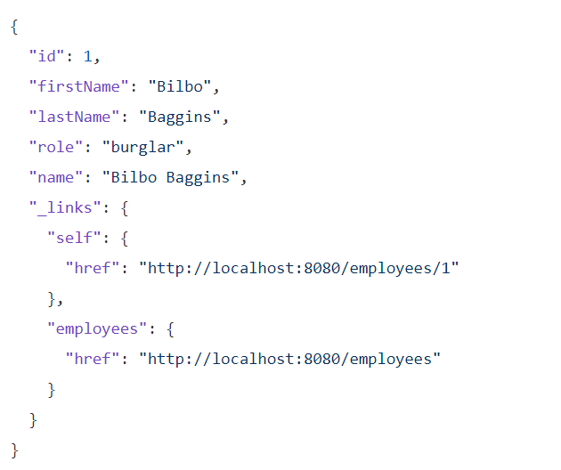
REST (Representational State Transfer)
An example
A proper REST response to a GET call to http://localhost:8080/employees/1 REST endpoint.
Source: https://spring.io/guides/tutorials/rest/

Slide 13
REST (Representational State Transfer)
Design Principles
REST is designed to facilitate strong decoupling between the client and the server to facilitate internet-scale usage.
Follows a Request/ Response style of communication.
Some Terms:
Client – the consumer of services via the API
Server – the provider of services and the API that exposes these services
Resource – any content that the server responds with to a client request
Notes:
Resource is any content (e.g., images, text etc.)

Slide 14
REST (Representational State Transfer)
Design Principles (contd.)
When a client requests for a resource, the server will respond with
the representation of the resource in its current state (Usually JSON or XML)
and relevant hypermedia links (URIs) that can be used to change the state of the resource
Notes:
Resource is any content (e.g., images, text etc.)

Slide 15
REST: Six architectural constraints
Client-server architecture
Stateless
Cacheable
Uniform Interface
Layered system
Code on demand (Optional)
Let’s examine each constraint.

Slide 16
REST: Six architectural constraints
Client-server architecture
Maintain the clear separation of the client and the server,
To promote portability of the user interface
To promote low coupling between the client and the server
To improve scalability of the server components
To allow clients and servers grow independently

Slide 17
REST: Six architectural constraints
Stateless
Communication between clients and server must be stateless in nature
Each request from client to server must contain all the information necessary to understand the request and cannot take advantage of any stored context on the server.
Session state is kept entirely on the client.
Improves visibility, reliability, and scalability.

Slide 18
REST: Six architectural constraints
Cacheable
Cache constraints require that the data within a response to a request be implicitly or explicitly labeled as cacheable or non-cacheable.
If a response is cacheable, then a client cache is given the right to reuse that response data for later, equivalent requests.
Caching can eliminate requirement for some interactions thereby improving efficiency, scalability, and user-perceived performance.

Slide 19
REST: Six architectural constraints
Uniform Interface
Implementations are decoupled from the services they provide, which encourages independent evolvability.
Continued in the next slide…

Slide 20
REST: Six architectural constraints
Uniform Interface
Has four sub-constraints.
Self-descriptive messages - Each message going back and forth between the client and the server should contain enough information to process the message.
Identification of resources - Individual resources are identified in requests/ responses. This is done through URIs (Uniform Resource Identifiers). The resources themselves on the server are conceptually separate from the representations that are returned to the client.
Resource manipulation through representations - When a client holds a representation of a resource, including any metadata attached, it has enough information to modify or delete the resource's state
Hypermedia as the engine of application state (HATEOAS) – continued in the next slide…

Slide 21
REST: Six architectural constraints
Uniform Interface (continued…)
Hypermedia as the engine of application state (HATEOAS) - (Hey-tee-oh-s)
Having accessed an initial URI for the REST application a REST client should then be able to use server-provided links dynamically to discover all the available resources it needs.
As access proceeds, the server responds with text that includes hyperlinks to other resources that are currently available (Dynamic API).
There is no need for the client to be hard-coded with information regarding the structure of the server.
This is akin to a human user having to know only the main URL of a website. The rest of the URLs are discovered when consuming the site.

Slide 22
REST: Six architectural constraints
Layered system
Each layer only interacts with the layers above and below them.
The layered system style allows an architecture to be composed of hierarchical layers by constraining component behavior such that each component cannot "see" beyond the immediate layer with which they are interacting.
The layered system constraints enable network-based intermediaries such as proxies and gateways to be transparently deployed between a client and server using the Web’s uniform interface.
A network-based intermediary will intercept client-server communication for a specific purpose. Network-based intermediaries are commonly used for enforcement of security, response caching, and load balancing.

Slide 23
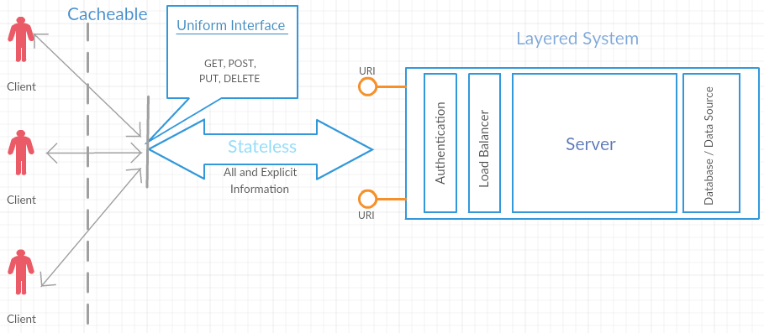
REST: Six architectural constraints
Layered system (continued…)
Source: REST API Design Rulebook (Mark Masse, Oreilly, 2011)

Slide 24
REST: Six architectural constraints
Code on demand (Optional)
REST allows client functionality to be extended by downloading and executing code in the form of applets or scripts.
This simplifies clients by reducing the number of features required to be pre-implemented.
This is the only optional constraint in REST.

Slide 25
True REST vs. RPC (Remote Procedure Calls)
Pretty URLs like /employees/10 aren’t REST.
Merely using HTTP methods such as GET, POST etc. is not REST.
Having all the CRUD operations laid out isn’t REST.
In such an API there is no way to know how to interact with the service without explicit help from the developers.
HATEOAS constraint is missing!

Slide 26
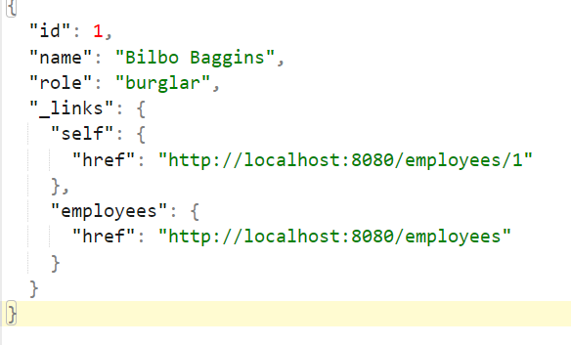
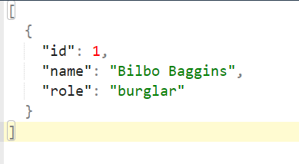
True REST vs. RPC (Remote Procedure Calls)
The response to a GET call to http://localhost:8080/employees/1 endpoint.
Just a JSON entity. No hyperlinks – Results in RPC
RESTful representation of the same entity

Slide 27
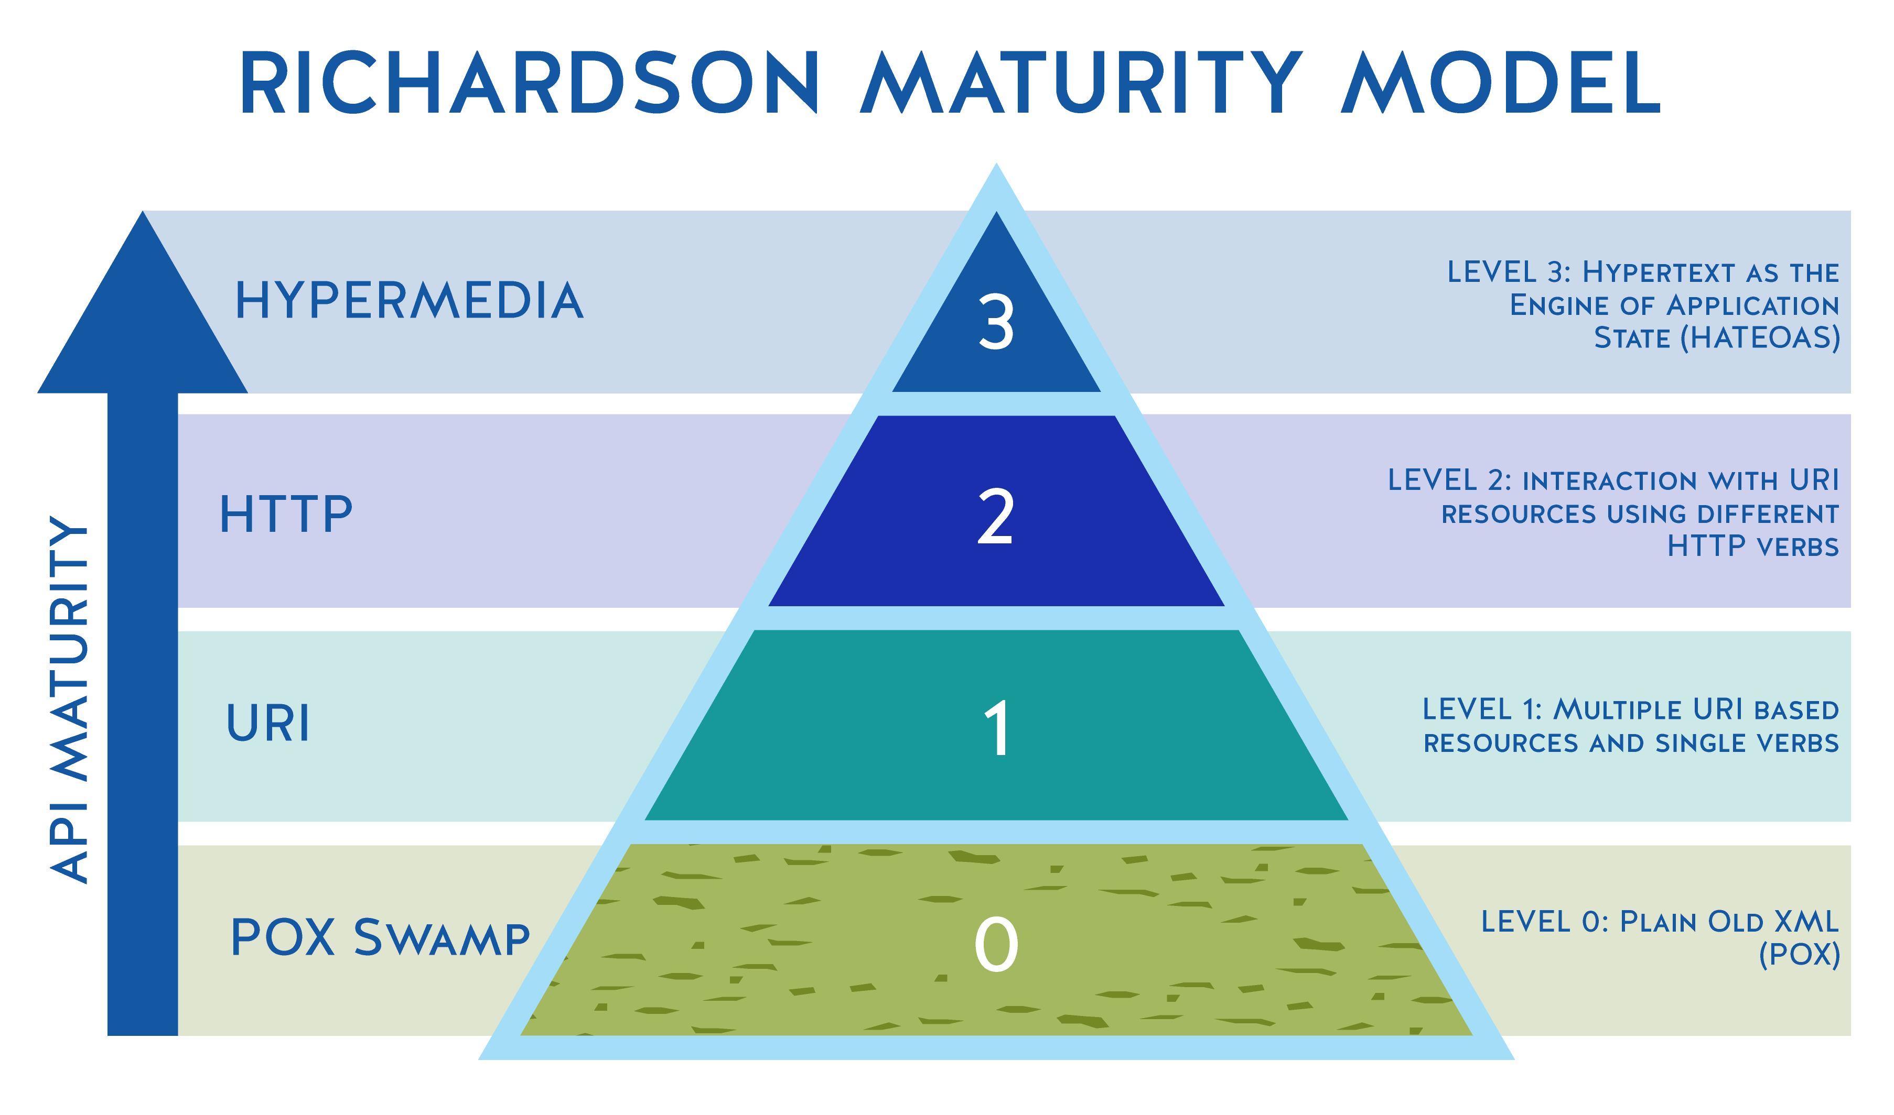
Richardson Maturity Model
It is a four-level scale that indicates extent of API conformity to the REST constraints.
Proposed by Leonard Richardson.
Source: https://devopedia.org/richardson-maturity-model

Slide 28
Richardson Maturity Model
Level-0: Swamp of POX
Usually exposes just one URI for the entire application. Uses HTTP POST for all actions, even for data fetch. SOAP or XML-RPC-based applications come under this level. POX stands for Plain Old XML. Could be JSON too.
Level-1: Resource-Based Address/URI
Introduces resources and allows to make requests to individual URIs (still all typically POST) for separate actions instead of exposing one universal endpoint (API).
Level-2: HTTP Verbs (Methods)
Fully utilize all HTTP commands or verbs such as GET, POST, PUT, and DELETE.
Level-3: HATEOAS
Full maturity. Utilizes URI, HTTP Methods and HATEOAS.

Slide 29
Some Facilitators of REST
HTTP
HTTP Methods – REST APIs utilize these to indicate the type of operation being performed.
GET – Reading a resource
POST – Writing a resource
PUT – Updating a resource
DELETE – Deleting a resource
HTTP Status Codes – REST APIs utilize these to denote the status of a particular request.
2XX – Successful responses range (e.g., 200 OK)
4XX – Client errors range (e.g., 404 NOT FOUND)
5XX – Server errors range (e.g., 500 INTERNAL SERVER ERROR)
List of HTTP status codes: HTTP response status codes

Slide 30
Some Facilitators of REST
HTTP (continued…)
HTTP Headers – These are used to pass along additional information/ meta data between the client and the server.
Content-type
Cache-control
Authorization
List of HTTP Headers: HTTP headers
It is important that proper HTTP methods, Headers and Status Codes are used in REST requests/ responses.

Slide 31
Some Facilitators of REST
JSON (JavaScript Object Notation) – A lightweight human readable format for storing and transporting data as key-value pairs.
HAL (Hypertext Application Language) – An open specification that provides a structure to represent RESTful resources
Source: https://spring.io/guides/tutorials/rest/

Slide 32
Some Best practices
Use correct HTTP methods, headers and status codes according to the operation being performed.
Accept and respond with JSON.
Always use proper authentication (e.g., OAuth, JWT etc.)
Give meaningful names to the URIs.
E.g.,
https://abcd.com/users/
https://abcd.com/users/2
Keep the API consistent.

Slide 33
More Best Practices
Self study activity
Read and follow this list of best practices from Microsoft: RESTful web API design
Make sure you apply these in your assignment as well!
More hands-on experience on REST APIs during the practical session.

Slide 34
Summary
Consuming web resources - Human vs. programs
Application Programming Interface (API)
Examples
REST
Six Architectural Constraints of REST
True REST vs. RPC (Remote Procedure Calls)
Richardson Maturity Model
Some Facilitators of REST
HTTP, JSON, HAL
Best Practices

Slide 35
References
An Introduction to Representational State Transfer (REST)
Architectural Styles and the Design of Network-based Software Architectures
Representational state transfer
Richardson Maturity Model
RESTful web API design

Slide 36

Thank You
Vishan.j@sliit.lk
nelum.a@sliit.lk

